Slide 1
COM337 Computer Graphics
Graphics Programming

Slide 2
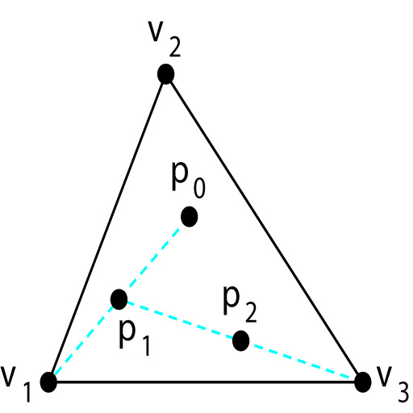
Sierpinski Gasket as an Example Shape
Start with a triangle
Select a point p randomly inside the triangle
Select one of triangle corners (vertices) at random
Find the point q which is halfway between p and the selected corner
Display q (mark it with a small circle)
Replace p with q and go to step 3

Slide 3
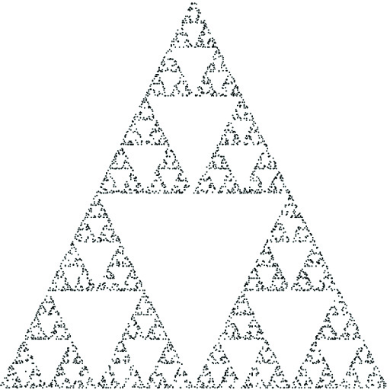
Sierpinski Gasket as an Example Shape

Slide 4
Immediate Mode Graphics
The pseudo-code on the right can generate this shape
This approach is known as immediate mode graphics
We are directly sending coordinates to the GPU and drawing as they are generated
What if we want to draw the points again?
function sierpinski() {
initialize_the_system();
p = find_initial_point();
for (some_number_of_points) {
q = generate_a_point(p);
display_the_point(q);
p = q;
}
}

Slide 5
Retained Mode Graphics v.1
If we first store the data, we can send and resend anytime
This version shows the retained mode graphics approach
We still send all coordinates to the GPU when we want to draw them
Modern graphics systems with a GPU leads to a third version
function sierpinski() {
initialize_the_system();
p = find_initial_point();
for (some_number_of_points) {
q = generate_a_point(p);
store_the_point(q);
p = q;
}
display_all_points();
}

Slide 6
Retained Mode Graphics v.2
Similar to the previous one
We separated the display process into 2 stages
Sending the data to the GPU
Displaying stored data
This version is better if we are going to display multiple images using same coordinates
function sierpinski() {
initialize_the_system();
p = find_initial_point();
for (some_number_of_points) {
q = generate_a_point(p);
store_the_point(q);
p = q;
}
send_all_points_to_GPU();
display_data_on_GPU();
}

Slide 7
Coordinates
By default, we are drawing and viewing inside a cube centered at origin between coordinates (-1,-1,-1) and (1,1,1)
These are our default clip coordinates
Shapes outside this area are clipped (cut) and will not appear on screen
Later, we will learn how we can change these settings so that we can draw shapes in any coordinates we want

Slide 8
Generating Sierpinski Gasket
const numPoints = 5000;
var vertices = [ vec2(-1.0, -1.0),
vec2(0.0, 1.0),
vec2(1.0, -1.0) ];
var u = scale(0.5, add(vertices[0], vertices[1]));
var v = scale(0.5, add(vertices[0], vertices[2]));
var p = scale(0.5, add(u, v));
points = [ p ];
for (var i = 1; i < numPoints; ++i) {
var j = Math.floor(Math.random() * 3);
p = scale(0.5, add(points[i-1], vertices[j]));
points.push(p);
}

Slide 9
WebGL/OpenGL as a State Machine
We can think of the graphics system as a finite state machine
Many GL functions change the state of the machine without doing anything else
E.g., gl.ClearColor(1.0, 0.0, 0.0, 1.0)
Makes the active/current clear color red
It doesn’t clear the screen to this color
The clear color remains red until it is changed to a different color

Slide 10
Versions of Functions
There are multiple versions of GL functions
gl.uniform3f(...)
gl.uniform2iv(…)
function name
dimension
gl.uniform3f(x,y,z)
belongs to WebGL canvas
x,y,z are float variables
gl.uniform3fv(p)
p is an array

Slide 11
Primitives
Primitives are the basic geometric shapes we use to display graphics
Points, Lines, Triangles, Polygons, Circles, etc.
Many APIs only provide simple primitives
-In WebGL, we only have points, lines, and triangles
We display more complex shapes by using many simple primitives (often approximating the shape)
There are graphics APIs that support other primitives such as text, circles, curves, surfaces, and solids.

Slide 12
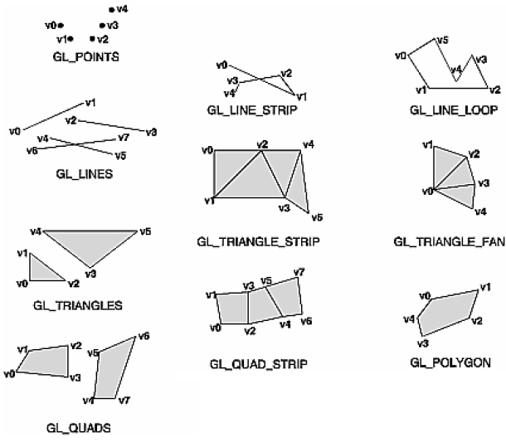
Primitives
X
X
X
X: OLD OPENGL

Slide 13
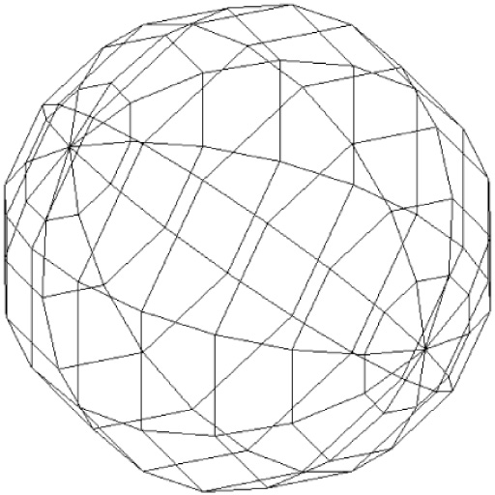
Approximating a Sphere
We can approximate a sphere by
A series of calls with
gl.drawArrays(gl.TRIANGLE_STRIP, …)
And 2 calls with
gl.drawArrays(gl.TRIANGLE_FAN, ...)

Slide 14
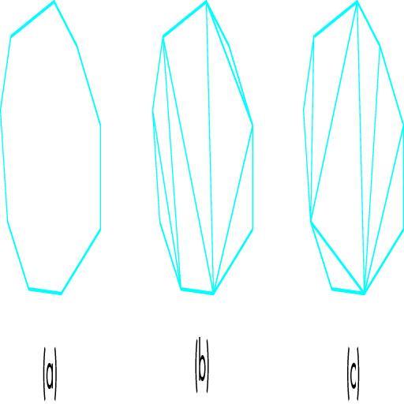
Triangulation

Slide 15
Text
As graphics systems focused on using GPU and rendering with lines and triangles, text primitives were eliminated over time
WebGL runs inside the browser and we can display better-looking text using a separate HTML canvas instead of trying to do it in the WebGL canvas

Slide 16
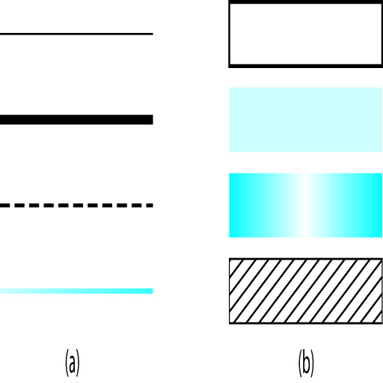
Attributes
The same geometric object can be displayed in many different ways
Properties that describe how an object should be rendered are called attributes
Color is an attribute for all primitives
A point can be shown in different sizes
A line’s thickness can change and it can be solid, dashed, …
A polygon can be filled with a single color or with a pattern

Slide 17
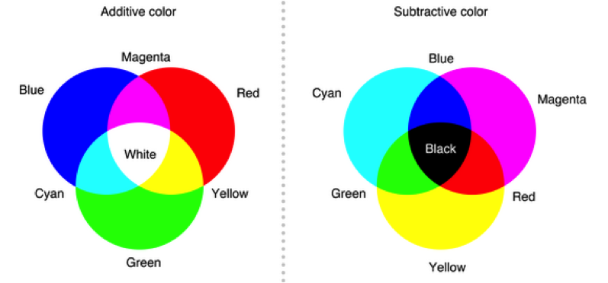
Color
Human visual system has three types of cones (color sensitive receptors located on the retina)
So, a display only needs three primary colors to produce color for a human observer
Additive vs. subtractive color models

Slide 18
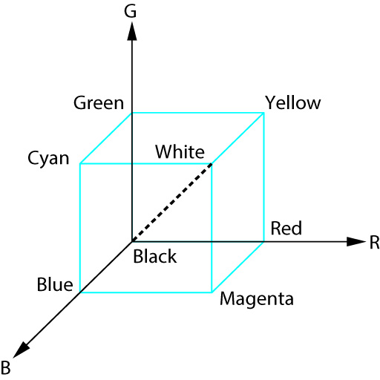
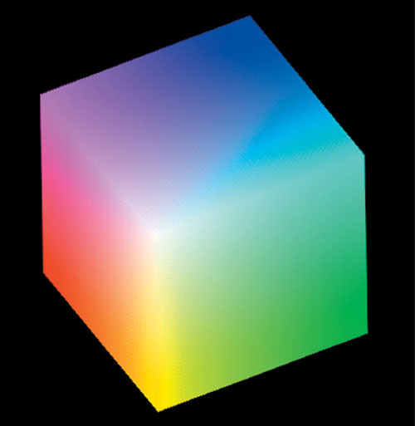
Color
We can view a color as a point in a color solid

Slide 19
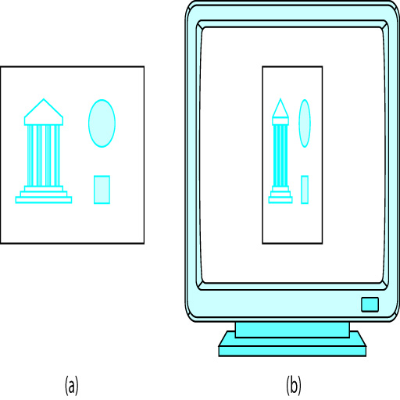
Aspect Ratio and Viewports
Aspect ratio of a rectangle is the ratio of its width to its height
In graphics programming, objects, viewing parameters and screen window are independent
This may cause undesirable effects if the viewing rectangle of the camera and window area of the canvas have different aspect ratios

Slide 20
Aspect Ratio and Viewports
Such distortions can be avoided if we make sure that clipping rectangle and display window have the same aspect ratio
By default, our graphics are displayed using the entire window (canvas) but this can be changed
The area inside the window (canvas) we use to display output is called viewport
Its place and size can be changed
gl.viewport(x, y, w, h);

Slide 21
The Gasket Program - HTML
<html>
<script id="vertex-shader" type="x-shader/x-vertex">
attribute vec4 vPosition;
void main() {
gl_PointSize = 2.0;
gl_Position = vPosition;
}
</script>
<script id="fragment-shader" type="x-shader/x-fragment">
precision mediump float;
void main() {
gl_FragColor = vec4(1.0, 0.0, 0.0, 1.0);
}
</script>

Slide 22
The Gasket Program - HTML
<script type="text/javascript" src="../Common/webgl-utils.js"></script>
<script type="text/javascript" src="../Common/initShaders.js"></script>
<script type="text/javascript" src="../Common/MV.js"></script>
<script type="text/javascript" src="gasket1.js"></script>
<body>
<canvas id="gl-canvas" width="512" height="512">
<!-- The following message is displayed if the browser doesn’t
-- support HTML5 -->
Sorry; your web browser does not support HTML5’s canvas element.
</canvas>
</body>
</html>

Slide 23
The Gasket Program - JS
var gl;
numPoints = 5000;
window.onload = function init() {
// Initialize points
var vertices = [
vec2(-1, -1),
vec2(0, 1),
vec2(1, -1)
];
var u = add(vertices[0], vertices[1]);
var v = add(vertices[0], vertices[2]);
var p = scale(0.5, add(u, v));
points = [ p ];
for (var i = 0; points.length < numPoints; ++i) {
var j = Math.floor(Math.random() * 3);
p = add(points[i], vertices[j]);
p = scale(0.5, p);
points.push(p);
}

Slide 24
The Gasket Program - JS
canvas = document.getElementById("gl-canvas");
gl = WebGLUtils.setupWebGL(canvas);
if (!gl) {
alert("WebGL isn’t available");
}
gl.viewport(0, 0, canvas.width, canvas.height);
gl.clearColor(1.0, 1.0, 1.0, 1.0);
// Load shaders and initialize attribute buffers
program = initShaders(gl, "vertex-shader", "fragment-shader");
gl.useProgram(program);

Slide 25
The Gasket Program - JS
var buffer = gl.createBuffer();
gl.bindBuffer(gl.ARRAY_BUFFER, buffer);
gl.bufferData( gl.ARRAY_BUFFER, flatten(points), gl.STATIC_DRAW );
var vPosition = gl.getAttribLocation(program, "vPosition");
gl.vertexAttribPointer(vPosition, 2, gl.FLOAT, false, 0, 0);
gl.enableVertexAttribArray(vPosition);
render();
}
function render() {
gl.clear(gl.COLOR_BUFFER_BIT);
gl.drawArrays(gl.POINTS, 0, numPoints);
}

